Slide 1

Waiting for What’s Right in a World Gone Wrong

Slide 2

God Leads His Troubled Children
Luke 1:26-45
What life or God encounter has troubled you?
Why shouldn’t you be troubled?
  You can admit your trouble.

Slide 3
God Leads His Troubled Children
So do not fear, for I am with you; do not be dismayed, for I am your God. I will strengthen you and help you; I will uphold you with my righteous right hand.
Isaiah 41:10

Slide 4
God Leads His Troubled Children
Luke 1:26-45
What life or God encounter has troubled you?
Why shouldn’t you be troubled?
  You can admit your trouble.
  God favors you.

Slide 5
  There is no fear in love. But perfect love drives out fear, because fear has to do with punishment. The one who fears is not made perfect in love. We love because he first loved us.
  1 John 4:18-20

Slide 6
God Leads His Troubled Children
Luke 1:26-45
What life or God encounter has troubled you?
Why shouldn’t you be troubled?
  You can admit your trouble.
  God favors you.
  God has a plan.
    God’s plan is good.

Slide 7
  For I know the plans I have for you," declares the LORD, "plans to prosper you and not to harm you, plans to give you hope and a future.
  Jeremiah 29:11

Slide 8
God Leads His Troubled Children
Luke 1:26-45
  God has a plan.
    God’s plan is good.
    Our plans are not always God’s plans.

Slide 9
  Many are the plans in a man's heart, but it is the LORD's purpose that prevails.
  Proverbs 19:21

Slide 10
God Leads His Troubled Children
Luke 1:26-45
  God has a plan.
    God’s plan is good.
    Our plans are not always God’s plans.
Submission is the key.

Slide 11
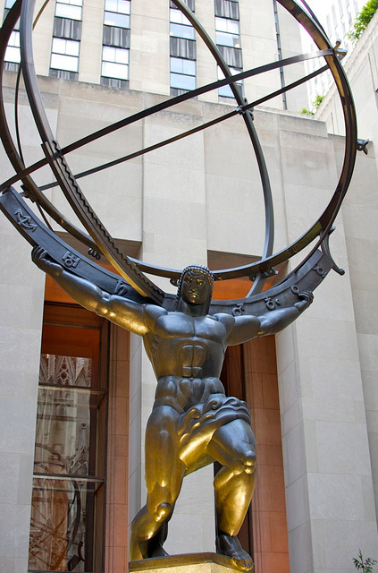

Slide 12
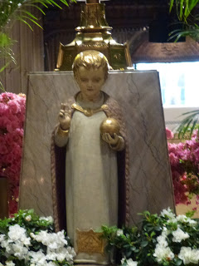

Slide 13
  "Come to me, all you who are weary and burdened, and I will give you rest. Take my yoke upon you and learn from me, for I am gentle and humble in heart, and you will find rest for your souls. For my yoke is easy and my burden is light."
  Matthew 11:28-30

