Slide 1
The Oneness Factor
Genesis 2:18-24

Slide 2


Slide 3


Slide 4
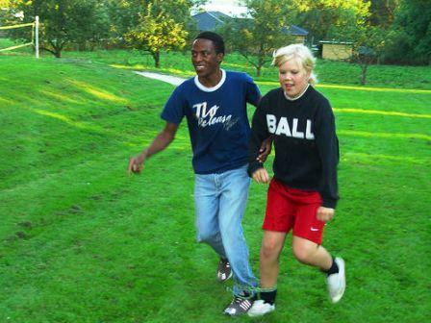

Slide 5
Four areas of oneness:
Physical oneness.

Slide 6
Now for the matters you wrote about: It is good for a man not to marry. But since there is so much immorality, each man should have his own wife, and each woman her own husband. The husband should fulfill his marital duty to his wife, and likewise the wife to her husband. The wife’s body does not belong to her alone but also to her husband.

Slide 7
In the same way, the husband’s body does not belong to him alone but also to his wife. Do not deprive each other except by mutual consent and for a time, so that you may devote yourselves to prayer. Then come together again so that Satan will not tempt you because of your lack of self-control.
1 Corinthians 7:1-5

Slide 8
Four areas of oneness:
Physical oneness.
  Seek to understand and meet the other’s desire.
Emotional oneness.
  Be vulnerable.

Slide 9
Therefore confess your sins to each other and pray for each other so that you may be healed.
James 5:16

Slide 10
Four areas of oneness:
Physical oneness.
  Seek to understand and meet the other’s desire.
Emotional oneness.
  Be vulnerable.
  Listen, identify, affirm, comfort, and express your love.
  Take time to be and do together.

Slide 11
Four areas of oneness:
Spiritual oneness.

Slide 12
Speak to one another with psalms, hymns and spiritual songs. Sing and make music in your heart to the Lord, ²⁰ always giving thanks to God the Father for everything, in the name of our Lord Jesus Christ.
Ephesians 5:19-20

Slide 13
“Again, I tell you that if two of you on earth agree about anything you ask for, it will be done for you by my Father in heaven. ²⁰ For where two or three come together in my name, there am I with them.”
Matthew 18:19-20

Slide 14
Four areas of oneness:
Spiritual oneness.
  Grow humbly and intentionally together.
Oneness of purpose.

Slide 15
… make my joy complete by being like-minded, having the same love, being one in spirit and purpose. Do nothing out of selfish ambition or vain conceit, but in humility consider others better than yourselves. Each of you should look not only to your own interests, but also to the interests of others.
Philippians 2:2-4

Slide 16
Four areas of oneness:
Spiritual oneness.
  Grow humbly and intentionally together.
Oneness of purpose.
  Requires communication, awareness, and consideration.

Slide 17


