Slide 1
Encountering God: What have we witnessed… God Calls us to New Places
Genesis 12:1-4, John 3:1-17

Slide 2
God calls us on new journeys.
It is always a faith journey.

Slide 3
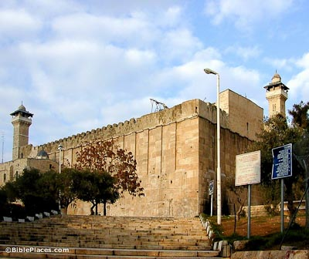

Slide 4
God calls us on new journeys.
It is always a faith journey.
The journey leads to a place of blessing.
We are blessed.
Others are blessed.

Slide 5
I will sprinkle clean water on you, and you will be clean; I will cleanse you from all your impurities and from all your idols. I will give you a new heart and put a new spirit in you; I will remove from you your heart of stone and give you a heart of flesh. And I will put my Spirit in you and move you to follow my decrees and be careful to keep my laws.
Ezekiel 36:25-27

Slide 6
God calls us on new journeys.
It is always a faith journey.
The journey leads to a place of blessing.
We are blessed.
Others are blessed.
Ultimately we are called to a journey of new life.

